Slide 1
Entanglement Spectrum, Topological Entanglement Entropy and a Quantum Hammersley-Clifford Theorem
Fernando G.S.L. Brandão
Microsoft Research
MIT 2016
based on joint work with
Kohtaro Kato
University of Tokyo

Slide 2
Quantum Information Theory
Goal: Lay down the theory for future quantum-based technology
(quantum computers, quantum cryptography, …)
Quant. Comm.
Entanglement theory
Q. error correc. + FT
Quantum comp.
Quantum complex. theo.

Slide 3
Quantum Information Theory
Goal: Lay down the theory for future quantum-based technology
(quantum computers, quantum cryptography, …)
Ultimate limits to information transmission
Quant. Comm.
Entanglement theory
Q. error correc. + FT
Quantum comp.
Quantum complex. theo.

Slide 4
Quantum Information Theory
Goal: Lay down the theory for future quantum-based technology
(quantum computers, quantum cryptography, …)
Ultimate limits to information transmission
Quant. Comm.
Entanglement theory
Q. error correc. + FT
Quantum comp.
Quantum complex. theo.
Entanglement as a resource

Slide 5
Quantum Information Theory
Goal: Lay down the theory for future quantum-based technology
(quantum computers, quantum cryptography, …)
Ultimate limits to information transmission
Quant. Comm.
Entanglement theory
Q. error correc. + FT
Quantum comp.
Quantum complex. theo.
Entanglement as a resource
Quantum computers are digital

Slide 6
Quantum Information Theory
Goal: Lay down the theory for future quantum-based technology
(quantum computers, quantum cryptography, …)
Ultimate limits to information transmission
Quant. Comm.
Entanglement theory
Q. error correc. + FT
Quantum comp.
Quantum complex. theo.
Quantum algorithms with exponential speed-up
Entanglement as a resource
Quantum computers are digital

Slide 7
Quantum Information Theory
Goal: Lay down the theory for future quantum-based technology
(quantum computers, quantum cryptography, …)
Ultimate limits to information transmission
Quant. Comm.
Entanglement theory
Q. error correc. + FT
Quantum comp.
Quantum complex. theo.
Quantum algorithms with exponential speed-up
Entanglement as a resource
Ultimate limits for efficient computation
Quantum computers are digital

Slide 8
QIT Connections
QIT
Quant. Comm.
Entanglement theory
Q. error correc. + FT
Quantum comp.
Quantum complex. theo.

Slide 9
QIT Connections
Condensed Matter
Strongly corr. systems
Topological order
Spin glasses
QIT
Quant. Comm.
Entanglement theory
Q. error correc. + FT
Quantum comp.
Quantum complex. theo.

Slide 10
QIT Connections
Condensed Matter
Strongly corr. systems
Topological order
Spin glasses
QIT
Quant. Comm.
Entanglement theory
Q. error correc. + FT
Quantum comp.
Quantum complex. theo.
StatMech
Thermalization
Thermo@nano scale
Quantum-to-Classical Transition

Slide 11
QIT Connections
Condensed Matter
HEP/GR
Strongly corr. systems
Topological order
Spin glasses
Topolog. q. field theo.
Black hole physics
Holography
QIT
Quant. Comm.
Entanglement theory
Q. error correc. + FT
Quantum comp.
Quantum complex. theo.
StatMech
Thermalization
Thermo@nano scale
Quantum-to-Classical Transition

Slide 12
QIT Connections
Condensed Matter
HEP/GR
Strongly corr. systems
Topological order
Spin glasses
Topolog. q. field theo.
Black hole physics
Holography
QIT
Quant. Comm.
Entanglement theory
Q. error correc. + FT
Quantum comp.
Quantum complex. theo.
StatMech
Exper. Phys.
Ion traps, linear optics, optical lattices, cQED,
superconduc. devices,
many more
Thermalization
Thermo@nano scale
Quantum-to-Classical Transition

Slide 13
This Talk
Goal: give one example of these emerging connections:
Study scaling of entanglement in some physical states
QIT
Condensed Matter
Ground states
Area law
Entanglement Spectrum
Thermal States
Relative Entropy
Strong Subadditivity
Fawzi-Renner Bound

Slide 14
Area Law
Area law assumption: For every region X,
X
X^{c}
Topological
entanglement entropy
correlation length
(Kitaev, Preskill ‘05, Levin, Wen ‘05)
Expected to hold in models with a correlation length.
But not always true.
In this talk we consider this form of area law as an assumption
and analyse what are its consequences.

Slide 15
Quantum Information 1.01: Fidelity
… it’s a measure of distinguishability between two quantum states.
Given two quantum states their fidelity is given by
It tells how distinguishable they are by any quantum
measurement

Slide 16
Quantum Information 1.01: Relative Entropy
… it’s another measure of distinguishability between two quantum states.
Def:
Gives optimal exponent for distinguishing the two states
(in asymmetric hypothesis testing; Stein’s Lemma)
Pinsker’s inequality:

Slide 17
Conditional Mutual Information
Given ,
Strong sub-additivity:

Slide 18
Conditional Mutual Information
Given ,
Strong sub-additivity:
Fawzi-Renner ‘14:

Slide 19
Conditional Mutual Information
Given ,
Strong sub-additivity:
(Fawzi-Renner ‘14) If , there is a channel
s.t.
Can reconstruct the state ABC from reduction on AB by acting on B only

Slide 20
Consequence of Area Law:
State Reconstruction
Area law assumption: For every region X,
B
C
A
l
Topological
entanglement entropy
correlation length
A
B
C
For every ABC with trivial topology:
(Kitaev ‘12) implies the state can be created by short-depth circuit
(Kim ‘14) Implies the state can be constructed from local parts

Slide 21
Topological Entanglement Entropy
(Kitaev, Preskill ‘05, Levin, Wen ‘05)
Area law assumption: For every region X,
A
B
B
l
C
Topological
entanglement entropy
correlation length
Conditional Mutual Information:
Assuming area law holds:

Slide 22
Entanglement Spectrum
: eigenvalues of reduced density
matrix on X
X
X^{c}
Also known as Schmidt eigenvalues
of the state

Slide 23
Entanglement Spectrum
: eigenvalues of reduced density
matrix on X
X
X^{c}
Also known as Schmidt eigenvalues
of the state
(Haldane, Li ’08, ….)
For FQHE, entanglement spectrum matches the low energies of a CFT acting on the boundary of X

Slide 24
Entanglement Spectrum
: eigenvalues of reduced density
matrix on X
X
X^{c}
Also known as Schmidt eigenvalues
of the state
(Haldane, Li ’08, ….)
For FQHE, entanglement spectrum matches the low energies of a CFT acting on the boundary of X
(Cirac, Poiblanc, Schuch, Verstraete ’11, ….)
Numerical studies with PEPS.
For topologically trivial systems (AKLT, Heisenberg models):
entanglement spectrum matches the energies of a local Hamiltonian on boundary
For topological systems (Toric code): needs non-local Hamiltonian

Slide 25
Entanglement Spectrum
: eigenvalues of reduced density
matrix on X
X
X^{c}
Also known as Schmidt eigenvalues
of the state
(Haldane, Li ’08, ….)
For FQHE, entanglement spectrum matches the low energies of a CFT acting on the boundary of X
(Cirac, Poiblanc, Schuch, Verstraete ’11, ….)
Numerical studies with PEPS.
For topologically trivial systems (AKLT, Heisenberg models):
entanglement spectrum matches the energies of a local Hamiltonian on boundary
For topological systems (Toric code): needs non-local Hamiltonian
How general are these findings? Can we make them more precise?

Slide 26
Result 1: Boundary State
thm 1 Suppose satisfies the area law assumption. Then
A
B
B
C

Slide 27
Result 1: Boundary State
thm 1 Suppose satisfies the area law assumption. Then
Suppose . Then there is a local s.t.
B₂
B₃
…
B_{k-2}
B_{k-1}
B₁
B_{k}
B_{2k}
…
B_{k+2}
B_{k+1}

Slide 28
Result 1: Boundary State
thm 1 Suppose satisfies the area law assumption. Then
Suppose . Then there is a local s.t.
Local ”boundary Hamiltonian”
Non-local ”boundary Hamiltonian”

Slide 29
Result 1: Boundary State
thm 1 Suppose satisfies the area law assumption. Then
Suppose . Then there is a local s.t.
Obs: Correlation length of the state determines temperature
of the thermal state ( )

Slide 30
Result 2: Entanglement Spectrum
thm 2 Suppose satisfies the area law assumption
with . Then
B₁
B₂
B₃
X
X’
…
B_{l-1}
B_{l}

Slide 31
Result 2: Entanglement Spectrum
thm 2 Suppose satisfies the area law assumption
with . Then
If , then for every k there is no local Hamilatonian H s.t.

Slide 32
From thm 1 to thm 2
X
B
X’

Slide 33
From thm 1 to thm 2
X
B
X’
since is a pure state

Slide 34
From thm 1 to thm 2
X
B
X’

Slide 35
From thm 1 to thm 2
X
B
X’
If ,

Slide 36
How to prove thm 1?
We’ll start with the second part. Recap:
Suppose . Then there is a local s.t.
B₂
B₃
…
B_{k-2}
B_{k-1}
B₁
B_{k}
B_{2k}
…
B_{k+2}
B_{k+1}
By area law:
The idea is to show this implies the state is approximately thermal

Slide 37
Markov Networks
x₃
x₇
x₉
x₁
x₆
x₄
x₈
x₂
x₁₀
x₅
We say r.v. x₁, …, x_{n} on a graph G form a Markov Network if
x_{i} is indendent of all other x’s conditioned on its neighbors
I.e. Let N_{i} be set of neighbors of vertex i. Then for every i,

Slide 38
Hammersley-Clifford Theorem
x₃
x₇
x₉
x₁
x₆
x₄
x₈
x₂
x₁₀
x₅
(Hammersley-Clifford ‘71) Let G = (V, E) be a graph and P(V) be a positive probability distribution over r.v. located at the vertices of G. The pair (P(V), G) is a Markov Network if, and only if, the probability P can be expressed as P(V) = e^{H(V)}/Z where
is a sum of real functions h_{Q}(Q) of the r.v. in cliques Q.

Slide 39
Quantum Hammersley-Clifford Theorem
q₃
q₇
q₉
q₁
q₆
q₄
q₈
q₂
q₁₀
q₅
(Leifer, Poulin ‘08, Brown, Poulin ‘12) An analogous result holds replacing classical Hamiltonians by commuting quantum Hamiltonians
(obs: quantum version more fragile; only works for graphs with no 3-cliques)
Can we get a similar characterization for general quantum thermal states?

Slide 40
Approximate Quantum Hammersley-Clifford Theorem?
Def: We say a quantum state is a (l, eps)-approximate Markov network if for every
regions ABC s.t. B shields A from C
and B has width l,
l
A
B
C
Conjecture: Approximate Markov Networks are equivalent to Gibbs states of general quantum local Hamiltonians
(at least on regular lattices)

Slide 41
Approximate Quantum Hammersley-Clifford Theorem for 1D Systems
A
B
C
thm
Let H be a local Hamiltonian on n qubits. Then
Gibbs state @ temperature T:

Slide 42
Approximate Quantum Hammersley-Clifford Theorem for 1D Systems
A
B
C
thm
Let H be a local Hamiltonian on n qubits. Then
Let be a state on n qubits s.t. for every split ABC with |B| > m, . Then

Slide 43
Proof Part 2
X₁
X₂
X₃
m
Let be the maximum entropy state s.t.
Fact 1 (Jaynes’ Principle):
Fact 2
Let’s show it’s small

Slide 44
Proof Part 2
X₁
X₂
X₃
m
SSA

Slide 45
Proof Part 2
X₁
X₂
X₃
m

Slide 46
Proof Part 2
X₁
X₂
X₃
m

Slide 47
Proof Part 2
X₁
X₂
X₃
m
Since

Slide 48
Proof Part 2
X₁
X₂
X₃
m
Since

Slide 49
Proof Part 1
Recap: Let H be a local Hamiltonian on n qubits. Then
We show there is a recovery channel from B to BC reconstructing the state on ABC from its reduction on AB.

Slide 50







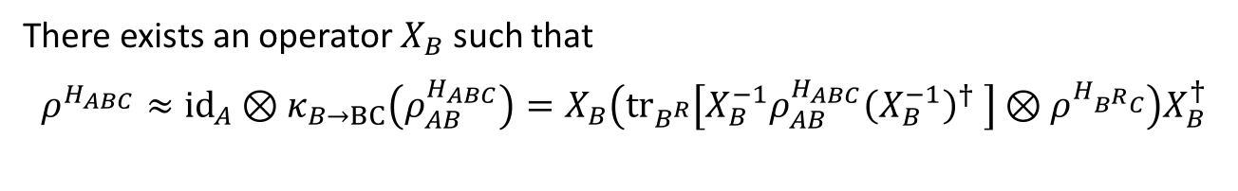
Structure of Recovery Map
There exists an operator $X_{B}$ such that
$$ρ^{H_{ABC}}≈{id}_{A}⊗κ_{B→BC}\left(ρ_{AB}^{H_{ABC}}\right)=X_{B}\left({tr}_{B^{R}}\left[X_{B}^{−1}ρ_{AB}^{H_{ABC}}{\left(X_{B}^{−1}\right)}^{†} \right]⊗ρ^{H_{B^{R}C}}\right)X_{B}^{†}$$
$$A$$
$$B^{L}$$
$$B^{R}$$
$$A$$
$$B^{L}$$
$$B^{R}$$
$$A$$
$$B^{L}$$
$$B^{R}$$
$$C$$
$$A$$
$$B^{L}$$
$$B^{R}$$
$$C$$

Slide 51
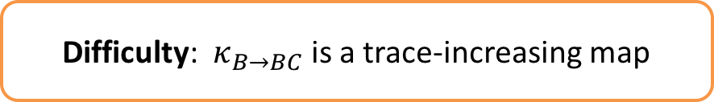
Structure of Recovery Map
There exists an operator $X_{B}$ such that
$$ρ^{H_{ABC}}≈{id}_{A}⊗κ_{B→BC}\left(ρ_{AB}^{H_{ABC}}\right)=X_{B}\left({tr}_{B^{R}}\left[X_{B}^{−1}ρ_{AB}^{H_{ABC}}{\left(X_{B}^{−1}\right)}^{†} \right]⊗ρ^{H_{B^{R}C}}\right)X_{B}^{†}$$
$$A$$
$$B^{L}$$
$$B^{R}$$
$$A$$
$$B^{L}$$
$$B^{R}$$
Difficulty: $κ_{B→BC}$ is a trace-increasing map
$$A$$
$$B^{L}$$
$$B^{R}$$
$$C$$
$$A$$
$$B^{L}$$
$$B^{R}$$
$$C$$

Slide 52






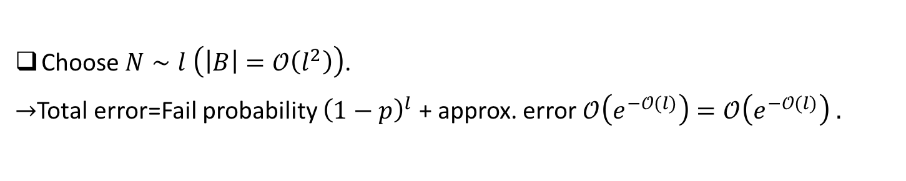


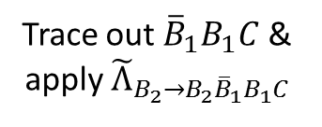
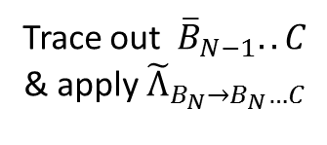








Repeat-until-success Method
We normalize $κ_{B→BC}$ and define a CPTD-map ${\tilde{Λ}}_{B→BC}$.
$→$ Succeed to recover with a constant probability $p$.
$$A$$
$$B_{N}$$
$${\overline{B}}_{N−1}$$
$$B_{N−1}$$
$${\overline{B}}_{2}$$
$$B_{2}$$
$${\overline{B}}_{1}$$
$$B_{1}$$
$$C$$
$$l$$
$$2l$$
Fail
Trace out ${{\overline{B}}_{1}B}_{1}C$ & apply ${\tilde{Λ}}_{B_{2}→{B_{2}{\overline{B}}_{1}B}_{1}C}$
Fail
Fail
Trace out ${\overline{B}}_{N−1}..C$ & apply ${\tilde{Λ}}_{B_{N}→B_{N}…C}$
Fail
Apply ${\tilde{Λ}}_{B_{1}→B_{1}C}$
$$⋯$$
Success
Success
Success
Obtain a state $≈ρ^{H_{ABC}}$
$$⋯$$
Choose $N∼l \left(\left|B\right|=𝒪\left(l^{2}\right)\right)$.
$→$Total error=Fail probability ${\left(1−p\right)}^{l}$ + approx. error $𝒪\left(e^{−𝒪(l)}\right)=𝒪\left(e^{−𝒪(l)}\right) .$

Slide 53
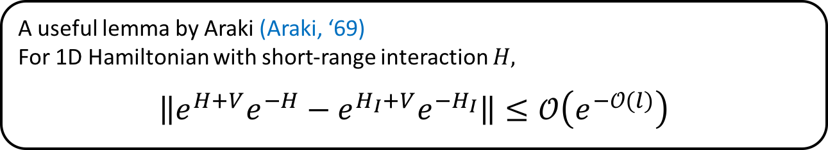



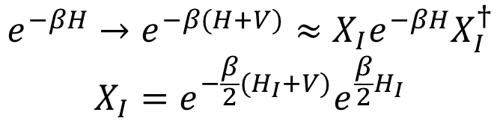
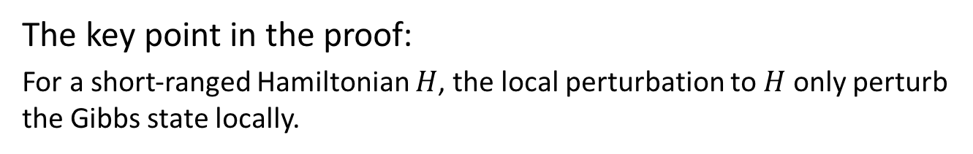
Locality of Perturbations
The key point in the proof:
For a short-ranged Hamiltonian $H$, the local perturbation to $H$ only perturb the Gibbs state locally.
$$l$$
$$I$$
$$V$$
A useful lemma by Araki (Araki, ‘69)
For 1D Hamiltonian with short-range interaction $H,$
$$\left\|e^{H+V}e^{−H}−e^{H_{I}+V}e^{−H_{I}}\right\|≤𝒪\left(e^{−𝒪(l)}\right)$$
$$e^{−βH}→e^{−β(H+V)}≈X_{I}e^{−βH}X_{I}^{†}$$
$$X_{I}=e^{−\frac{β}{2}(H_{I}+V)}e^{\frac{β}{2}H_{I}}$$
Local

Slide 54
Proof thm 1 part 2
We’ll start with the second part. Recap:
Suppose . Then there is a local s.t.
Apply 1D approximate quantum Hammersley-Clifford thm to get
With l = n/m. Choose m = O(log(n)) to make error small

Slide 55
Proof thm 1 part 1
thm 1 Suppose satisfies the area law assumption. Then
A
B
B
C

Slide 56
Proof thm 1 part 1
We follow the strategy of (Kato et al ‘15) for the zero-correlation length case
Area Law implies
A
B₁
B₁
B₂
B₂
C
By Fawzi-Renner Bound, there are channels s.t.

Slide 57
Proof thm 1 part 1
Define:
We have
It follows that C can be reconstructed from B. Therefore

Slide 58
Proof thm 1 part 1
Define:
We have
It follows that C can be reconstructed from B. Therefore
Since
with
So

Slide 59
Proof thm 1 part 1
Since
Let R₂ be the set of Gibbs states of Hamiltonians H = H_{AB} + H_{BC}. Then

Slide 60
Open Problems
What happens in dim bigger than 2?
Can we prove the approximate Markov property for general quantum states?
Can we prove the converse, i.e. that approximate quantum Markov Networks are approximately thermal?
Are two copies of the entanglement spectrum necessary to get a local boundary model?
Thanks!

