Slide 1
Quantum Information, Entanglement, and Many-Body Physics
Fernando G.S.L. Brandão
University College London
Caltech, January 2014

Slide 2
Quantum Information Theory
Goal: Lay down the theory for future quantum-based technology
(quantum computers, quantum cryptography, …)
Quant. Comm.
Entanglement theory
Q. error correc. + FT
Quantum comp.
Quantum complex. theo.

Slide 3
Quantum Information Theory
Goal: Lay down the theory for future quantum-based technology
(quantum computers, quantum cryptography, …)
Ultimate limits to information transmission
Quant. Comm.
Entanglement theory
Q. error correc. + FT
Quantum comp.
Quantum complex. theo.

Slide 4
Quantum Information Theory
Goal: Lay down the theory for future quantum-based technology
(quantum computers, quantum cryptography, …)
Ultimate limits to information transmission
Quant. Comm.
Entanglement theory
Q. error correc. + FT
Quantum comp.
Quantum complex. theo.
Entanglement as a resource

Slide 5
Quantum Information Theory
Goal: Lay down the theory for future quantum-based technology
(quantum computers, quantum cryptography, …)
Ultimate limits to information transmission
Quant. Comm.
Entanglement theory
Q. error correc. + FT
Quantum comp.
Quantum complex. theo.
Entanglement as a resource
Quantum computers are digital

Slide 6
Quantum Information Theory
Goal: Lay down the theory for future quantum-based technology
(quantum computers, quantum cryptography, …)
Ultimate limits to information transmission
Quant. Comm.
Entanglement theory
Q. error correc. + FT
Quantum comp.
Quantum complex. theo.
Quantum algorithms with exponential speed-up
Entanglement as a resource
Quantum computers are digital

Slide 7
Quantum Information Theory
Goal: Lay down the theory for future quantum-based technology
(quantum computers, quantum cryptography, …)
Ultimate limits to information transmission
Quant. Comm.
Entanglement theory
Q. error correc. + FT
Quantum comp.
Quantum complex. theo.
Quantum algorithms with exponential speed-up
Entanglement as a resource
Ultimate limits for efficient computation
Quantum computers are digital

Slide 8
QIT Connections
QIT
Quant. Comm.
Entanglement theory
Q. error correc. + FT
Quantum comp.
Quantum complex. theo.

Slide 9
QIT Connections
Condensed Matter
Strongly corr. systems
Topological order
Spin glasses
QIT
Quant. Comm.
Entanglement theory
Q. error correc. + FT
Quantum comp.
Quantum complex. theo.

Slide 10
QIT Connections
Condensed Matter
Strongly corr. systems
Topological order
Spin glasses
QIT
Quant. Comm.
Entanglement theory
Q. error correc. + FT
Quantum comp.
Quantum complex. theo.
StatMech
Thermalization
Thermo@nano scale
Quantum-to-Classical Transition

Slide 11
QIT Connections
Condensed Matter
HEP/GR
Strongly corr. systems
Topological order
Spin glasses
Topolog. q. field theo.
Black hole physics
Holography
QIT
Quant. Comm.
Entanglement theory
Q. error correc. + FT
Quantum comp.
Quantum complex. theo.
StatMech
Thermalization
Thermo@nano scale
Quantum-to-Classical Transition

Slide 12
QIT Connections
Condensed Matter
HEP/GR
Strongly corr. systems
Topological order
Spin glasses
Topolog. q. field theo.
Black hole physics
Holography
QIT
Quant. Comm.
Entanglement theory
Q. error correc. + FT
Quantum comp.
Quantum complex. theo.
StatMech
Exper. Phys.
Ion traps, linear optics, optical lattices, cQED,
superconduc. devices,
many more
Thermalization
Thermo@nano scale
Quantum-to-Classical Transition

Slide 13
This Talk
Goal: give examples of these connections:
Entanglement in many-body systems
- area law in 1D from finite correlation length
- product-state approximation to low-energy states in
high dimensions
2. (time permitting) Quantum-to-Classical Transition
- show that distributed quantum information
becomes classical (quantum Darwinism)

Slide 14

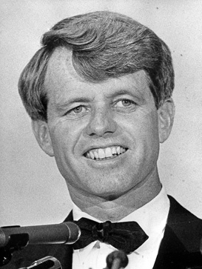
Entanglement
Entanglement in quantum information science is a resource
(teleportation, quantum key distribution, metrology, …)
Ex. EPR pair
How to quantify it?
Bipartite Pure State Entanglement
Given , its entropy of entanglement is
Reduced State:
Entropy: (Renyi Entropies: )

Slide 15
Entanglement in Many-Body Systems
A quantum state ψ of n qubits is a vector in ≅
For almost every state ψ, S(X)_{ψ} ≈ |X| (for any X with |X| < n/2)
|X| := ♯qubits in X
Almost maximal entanglement
Exceptional Set

Slide 16
Area Law
Area(X)
ψ
Def: ψ satisfies an area law if there is c > 0 s.t. for every region X,
S(X) ≤ c Area(X)
X
Entanglement is Holographic
X^{c}

Slide 17
Area Law
Area(X)
ψ
Def: ψ satisfies an area law if there is c > 0 s.t. for every region X,
S(X) ≤ c Area(X)
X
Entanglement is Holographic
X^{c}
When do we expect an area law?
Low-energy states of many-body local models
H_{ij}

Slide 18
Area Law
Area(X)
ψ
Def: ψ satisfies an area law if there is c > 0 s.t. for every region X,
S(X) ≤ c Area(X)
X
Entanglement is Holographic
X^{c}
When do we expect an area law?
Low-energy states of many-body local models
H_{ij}
(Bombeli et al ’86) massless free scalar field (connection to Bekenstein-Hawking entropy)
(Vidal et al ‘03; Plenio et al ’05, …) XY model, quasi-free bosonic and fermionic models, …
(Holzhey et al ‘94; Calabrese, Cardy ‘04) critical systems described by CFT (log correction)
(Aharonov et al ‘09; Irani ‘10) 1D model with volume scaling of entanglement entropy!
…

Slide 19
Why Area Law is Interesting?
Connection to Holography.
Interesting to study entanglement in physical states with an eye on quantum information processing.
Area law appears to be connected to our ability to write-down simple Ansatzes for the quantum state.
(e.g. tensor-network states)
This is known rigorously in 1D:

Slide 20
Matrix Product States
(Fannes, Nachtergaele, Werner ’92; Affleck, Kennedy, Lieb, Tasaki ‘87)
D : bond dimension
Only nD² parameters.
Local expectation values computed in nD³ time
Variational class of states for powerful DMRG
Generalization of product states (MPS with D=1)

Slide 21
MPS Area Law
X
Y
For MPS, S(ρ_{X}) ≤ log(D)
(Vidal ’03; Verstraete, Cirac ‘05)
If ψ satisfies S(ρ_{X}) ≤ log(D) for all X,
then it has a MPS description of bond dim. D
(obs: must use Renyi entropies)

Slide 22
Correlation Length
ρ
Correlation Function:
X
For pure state Ψ
Z
Correlation Length:
ψ has correlation length ξ if for every regions X, Z:
cor(X : Z)_{ψ} ≤ 2^{- dist(X, Z) / ξ}

Slide 23
When there is a finite
correlation length?
(Araki ‘69) In 1D at any finite temperature T
(for ρ = e^{-H/T}/Z; ξ = O(1/T))
(Hastings ‘04) In any dim at zero temperature for gapped models
(for groundstates; ξ = O(1/gap))
(Hastings ’11; Hamza et al ’12; …) In any dim for models with mobility gap
(many-body localization)
(Kliesch et al ‘13) In any dim at large enough T
(Kastoryano et al ‘12) Steady-state of rapidly-mixing dissipative
processes (e.g. gapped Liovillians)

Slide 24
Area Law from Correlation Length?
ψ
X
X^{c}

Slide 25
Area Law from Correlation Length?
ψ
X
X^{c}
That’s incorrect!
Ex. For almost every n qubit state,
but for all i in X^{c},
Entanglement can be non-locally encoded (e.g. QECC, Topological Order)

Slide 26
Area Law from Correlation Length?
X
Y
Z
Suppose .

Slide 27
Area Law from Correlation Length?
l
X
Y
Z
Suppose .
Then
X is only entangled with Y

Slide 28
Area Law from Correlation Length?
l
X
Y
Z
Suppose .
Then
X is only entangled with Y
But there are states (data hiding, quantum expanders) for which
Cor(X:Y) <= 2^{-l} and
Small correlations in a fixed partition doesn’t mean anything

Slide 29
Area Law in 1D?
(Hastings ’04)
Finite Correlation
Length
???
Gapped Ham
Area Law
Vidal ‘03
MPS
Representation

Slide 30
Area Law in 1D
(Hastings ’07)
(Hastings ’04)
Finite Correlation
Length
???
Gapped Ham
Area Law
Vidal ‘03
thm (Hastings ‘07) For H with spectral gap Δ and unique groundstate Ψ₀, for every region X,
S(X)_{ψ} ≤ exp(c / Δ)
MPS
Representation
X
(Arad, Kitaev, Landau, Vazirani ‘12) S(X)_{ψ} ≤ c / Δ

Slide 31
Area Law in 1D
(Hastings ’07)
(Hastings ’04)
Finite Correlation
Length
???
Gapped Ham
Area Law
Vidal ‘03
(Rev. Mod. Phys. 82, 277 (2010))
“Interestingly, states that are defined by quantum expanders can have exponentially decaying correlations and still have large entanglement, as has been proven in (…)”
MPS
Representation

Slide 32
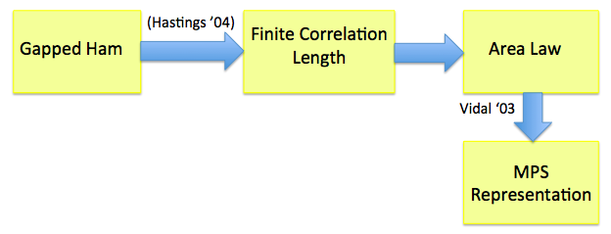
Correlation Length vs Entanglement I
thm 1 (B., Horodecki ‘12) Let be a quantum state in 1D with correlation length ξ. Then for every X,
X
The statement is only about quantum states,
no Hamiltonian involved.
Applies to gapless models with finite correlation length
e.g. systems with mobility gap (many-body localization)

Slide 33
Correlation Length vs Entanglement II
thm 2 Let be quantum states in 1D with correlation length ξ. Then for every k and X,
Applies to 1D gapped Hamiltonians with degenerate groundstates

Slide 34
Correlation Length vs Entanglement II
thm 2 Let be quantum states in 1D with correlation length ξ. Then for every k and X,
Def: have correlation length ξ if for every i and
regions X, Z:
cor_{P}(X : Z)_{ψi} ≤ 2^{- dist(X, Z) / ξ}
with
and
Applies to 1D gapped Hamiltonians with degenerate groundstates

Slide 35
Application: Adiabatic Quantum Computing in 1D
Quantum computing by dragging: Prepare ψ(0) and adiabatically change H(s) to obtain ψ(s_{f})
H(s_{f})
H(s)ψ_{s} = E_{0,s}ψ_{s}
Δ := min Δ(s)
H(0)
ψ₀
H(s)
ψ_{s}
(Aharonov et al ‘08)
Universal in 1D with unique groundstate and Δ > 1/poly(n)
(Hastings ‘09)
Non-universal in 1D with unique groundstate and constant Δ
(Bacon, Flammia ‘10)
Universal in 1D with exponentially many groundstates and constant Δ
…
cor: Adiabatic computation using 1D gapped H(s) with N groundstates can be simulated classically in time exp(N)poly(n)

Slide 36
Correlation Length vs Entanglement III
thm 3 Let be a mixed quantum state in 1D with correlation length ξ. Let . Then
Implies area law for thermal states at any non-zero temperature

Slide 37
Summing Up
Area law always holds in 1D whenever there is a
finite correlation length:
Groundstates (unique or degenerate) of gapped models
Groundstates of models with mobility gap (many-body localization)
Thermal states at any non-zero temperature
Steady-state of gapped dissipative dynamics
Implies that in all such cases the state has an
efficient classical parametrization as a MPS
(Useful for numerics – e.g. DMRG.
Limitations for quantum information processing)

Slide 38
Proof Idea
X
We want to bound the entropy of X using the fact the correlation length of the state is finite.
Need to relate entropy to correlations.

Slide 39
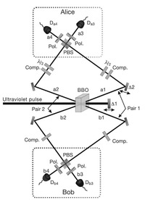
Entanglement Distillation
Consists of extracting EPR pairs from bipartite entangled states by Local Operations and Classical Communication (LOCC)
Central task in quantum information processing for distributing entanglement over large distances (e.g. entanglement repeater)
LOCC
(Pan et al ’03)

Slide 40

Optimal Entanglement
Distillation Protocol
We apply entanglement distillation to show large entropy implies large correlations
Entanglement distillation: Given Alice can distill
-S(A|B) = S(B) – S(AB) EPR pairs with Bob by making
a measurement with N≈ 2^{I(A:E)} elements, with
I(A:E) := S(A) + S(E) – S(AE), and communicating the
outcome to Bob. (Devetak, Winter ‘04)
A
B
E

Slide 41
Distillation Bound
l
X
Y
Z
B
E
A

Slide 42
Distillation Bound
l
X
Y
Z
B
E
A
S(X) – S(XZ) > 0
(EPR pair distillation rate)
Prob. of getting one of the 2^{I(X:Y)} outcomes

Slide 43
Area Law from “Subvolume Law”
l
X
Y
Z

Slide 44
Area Law from “Subvolume Law”
l
X
Y
Z

Slide 45
Area Law from “Subvolume Law”
l
X
Y
Z
Suppose S(Y) < l/(4ξ) (“subvolume law” assumption)
Since I(X:Y) < 2S(Y) < l/(2ξ), a correlation length ξ implies
Cor(X:Z) < 2^{-l/ξ} < 2^{-I(X:Y)}
Thus: S(X) < S(Y)

Slide 46
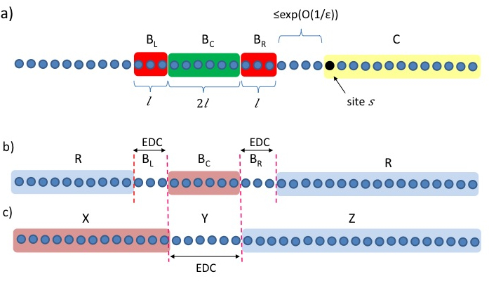
Actual Proof
We apply the bound from entanglement distillation to prove
finite correlation length -> Area Law in 3 steps:
c. Get area law from finite correlation length under assumption
there is a region with “subvolume law”
b. Get region with “subvolume law” from finite corr. length
and assumption there is a region of “small mutual information”
a. Show there is always a
region of “small mutual info”
Each step uses the assumption
of finite correlation length.

Slide 47
Area Law in Higher Dim?
Wide open…
Preliminary Result: It follows from stronger notion of decay of correlations
ψ
: postselected state after measurement on sites (1,…, k) with outcomes (i₁, …, i_{k})
X
Z
Do ”physical states” satisfy it??
Measurement on site k

Slide 48
Product States
A quantum state ψ of n qubits is a vector in ≅
Almost maximal entanglement
Exceptional Set: Low Entanglement

Slide 49
Product States
A quantum state ψ of n qubits is a vector in ≅
Almost maximal entanglement
Exceptional Set: Low Entanglement
No Entanglement

Slide 50
Approximation Scale
We want to approximate the minimum energy
(i.e. minimum eigenvalue of H):
Small total error:
Small extensive error:
E_{o}(H)+εl
Are all these low-lying states entangled?
E_{o}(H)

Slide 51
Mean-Field…
…consists in approximating the groundstate by a product state
It’s a mapping from quantum to classical Hamiltonians
Successful heuristic in Quantum Chemistry (Hartree-Fock)
Condensed matter
Intuition:
Mean-Field good when Many-particle interactions
Low entanglement in state

Slide 52
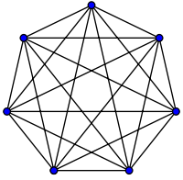
Product-State Approximation with Symmetry
(Raggio, Werner ’89) Hamiltonians on the complete graph
H_{ij}
(Kraus, Lewenstein, Cirac ’12) Translational and rotational symmetric Hamiltonians in D dimensions:
H_{ij}

Slide 53
Product-State Approximation without Symmetry
(B., Harrow ‘12) Let H be a 2-local Hamiltonian on qudits with interaction graph G(V, E) and |E| local terms.
Let {X_{i}} be a partition of the sites with each X_{i} having m sites.
E_{i} : expectation over X_{i}
Deg : degree of G
S(X_{i}) : entropy of
groundstate in X_{i}
X₂
size m
X₁

Slide 54
Product-State Approximation without Symmetry
(B., Harrow ‘12) Let H be a 2-local Hamiltonian on qudits with interaction graph G(V, E) and |E| local terms.
Let {X_{i}} be a partition of the sites with each X_{i} having m sites.
Then there are states ψ_{i} in X_{i} s.t.
E_{i} : expectation over X_{i}
Deg : degree of G
S(X_{i}) : entropy of
groundstate in X_{i}
X₂
size m
X₁

Slide 55
Approximation in terms of degree
…shows mean field becomes exact in high dim
∞-D
1-D
2-D
3-D

Slide 56
The Quantum PCP Conjecture
QMA-hardness theory main achievement:
(Kitaev ‘99, …., Gottesman-Irani ‘10) Groundstates of 1D translational-invariant models are as complex as groundstates of any local Ham.
Ansatz for GS
1D TI Ham.
Ansatz for GS
any Ham.

Slide 57
The Quantum PCP Conjecture
Quantum PCP conjecture There are models for which all states of energy below E₀ + εm are as complex as groundstates of any local Ham.
Ansatz with small extensive error
Ansatz with small total error
(state ψ for which
)
(state ψ for which
)
PCP Theorem (Arora et al ‘98) For classical Hamiltonians, to find a configuration of energy E₀ + εm is as hard as finding the minimum energy configuration.
Can we “quantize” the the PCP theorem?

Slide 58
Approximation in terms of degree
Implications to the quantum PCP problem :
Limits the range of possible ε for which the conjecture might be true.
Shows that attempts to “quantize” known proofs of the classical PCP theorem (e.g. (Arad et al ’08)) cannot work.

Slide 59
Approximation in terms of average entanglement
Product-states do a good job if entanglement of groundstate satisfies a subvolume law:
m < O(log(n))
X₃
X₂
X₁

Slide 60
Approximation in terms of average entanglement
If we have

Slide 61
Approximation in terms of average entanglement
If we have
In constrast, if merely , the theorem
shows product states give error

Slide 62
Intuition: Monogamy of Entanglement
Quantum correlations are non-shareable (e.g. (|0, 0> + |1, 1>)/√2)
Idea behind QKD: Eve cannot be correlated with Alice and Bob
Cannot be highly entangled with too many neighbors
S(X_{i}) quantifies how much entangled X_{i} can be with the rest
Proof uses quantum information-theoretic techniques to make this intuition precise

Slide 63
Mutual Information
Mutual Information
Pinsker’s inequality
Conditional MI
Chain Rule
Upper bound
4+5 for some t ≤ k

Slide 64
Quantum Mutual Information
Mutual Information
Pinsker’s inequality
Conditional MI
Chain Rule
Upper bound
4+5 for some t ≤ k

Slide 65
But…
…conditioning on quantum is problematic
For X, Y, Z random variables
No similar interpretation is known for I(X:Y|Z) with quantum Z

Slide 66
Conditioning Decouples
Idea that almost works. Suppose we have a distribution p(z₁,…,z_{n})
1. Choose i, j₁, …, j_{k} at random from {1, …, n}.
Then there exists t<k such that
Define
So
j₁
i
j_{k}
j₂

Slide 67
Conditioning Decouples
2. Conditioning on subsystems j₁, …, j_{t} causes, on average,
error <k/n and leaves a distribution q for which
, and so
By Pinsker:
Choosing k = εn
j_{t}
j₁
j₂

Slide 68
Informationally Complete Measurements
There exists a POVM M(ρ) = Σ_{k} tr(M_{k}ρ) |k><k|
s.t. for all k and ρ_{1…k}, σ_{1…k} in D((C^{d})^{k})
(Lacien, Winter ‘12, Montanaro ‘12)

Slide 69
Proof Overview
Measure εn qudits with M and condition on outcomes.
Incur error ε.
Most pairs of other qudits would have mutual information ≤ log(d) / ε deg(G) if measured.
Thus their state is within distance d³(log(d) / ε deg(G))^{1/2} of product.
Witness is a global product state. Total error is
ε + d⁶(log(d) / ε deg(G))^{1/2}.
Choose ε to balance these terms.
General case follows by coarse graining sites
(can replace log(d) by E_{i} H(X_{i}))

Slide 70
Classical from Quantum
How the classical world we perceive emerges from quantum mechanics?
Decoherence: lost of coherence due to interactions with environment

Slide 71
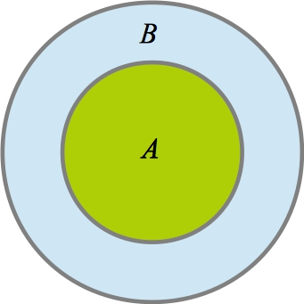
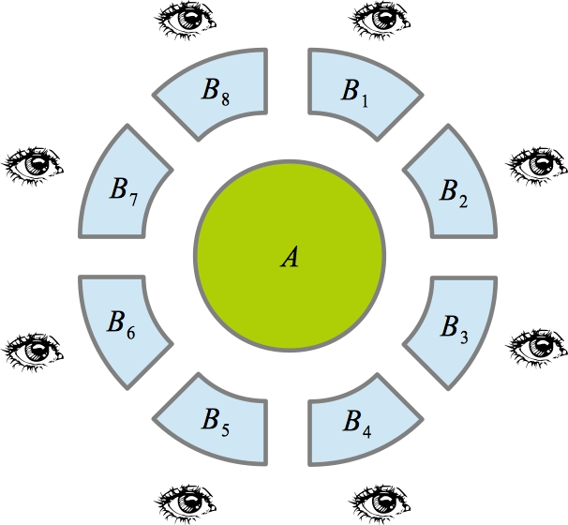
Classical from Quantum
How the classical world we perceive emerges from quantum mechanics?
Decoherence: lost of coherence due to interactions with environment
We only learn information about a quantum system indirectly
by accessing a small part of its environment.
E.g. we see an object by observing a tiny fraction of its photon environment

Slide 72
Quantum Darwinism in a Nutshell
(Zurek ’02; Blume-Kohout, Poulin, Riedel, Zwolak, ….)
Objectivity of observables: Observers accessing a quantum system by proving part of its environment can only learn about the measurement of a preferred observer
Objectivity of outcomes: Different observes accessing different parts of the environment have almost full information about the preferred observable and agree on what they observe
only contains information about the measurement of on
And almost all B_{j} have close to full information
about the outcome of the measurement

Slide 73
Quantum Darwinism: Examples
(Riedel, Zurek ‘10) Dieletric sphere interacting with photon bath: Proliferation of information about the position of the sphere
(Blume-Kohout, Zurek ‘07) Particle in brownian motion (bosonic bath): Proliferation of information about position of the particle
Is quantum Darwinism a general feature of quantum mechanics?
No: Let
For very mixing evolutions U = e^{-i t H}, is almost maximally mixed
for B_{j} as big as half total system size
Information is hidden (again, QECC is an example)
…

Slide 74
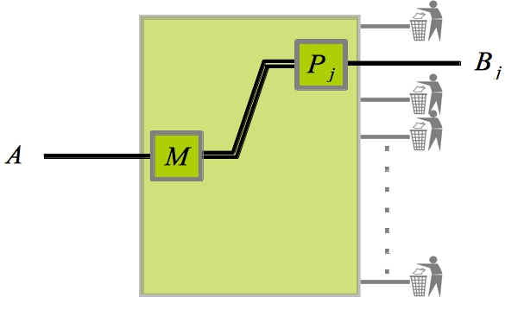
Objectivity of Observables is Generic
thm (B., Piani, Horodecki ‘13) For every , there exists a measurement {M_j} on S such that for almost all k,
Proof by monogamy of entanglement and quantum information-theoretic techniques (similar to before)

Slide 75
Summary
Thinking about entanglement from the perspective of quantum information theory is useful.
Growing body of connections between concepts/techniques in quantum information science and other areas of physics.
Thanks!

